Slide 1
CS2115 Computer Organization 2023/2024 Sem A
Chapter 4: ISA & MIPS Assembly
Dr. Nan Guan
Department of Computer Science
City University of Hong Kong

Slide 2
ISA
ISA: Instruction Set Architecture (or simply Architecture)
the interface between hardware and lowest level of software
has all information necessary to write a machine language program
Instruction set, register, memory, I/O, interrupt/exception handling …
Notes:
Why switch from circuits to ISA

Slide 3
Layers of a Computer
Applications
Middleware
Software
Operating system
Compiler/Assembler
Processor
Memory
I/O system
Hardware
ISA
Datapath & control
Digital Design
Circuit Design
Transistors
Semiconductor, silicon
Atoms, electrons

Slide 4
ISA
Popular ISA
IA-32 (x86), MIPS, ARM, RISC-V, SPARC, PowerPC, …
The same ISA have different implementations with different costs and performance, but all functionally identical to software

Slide 5
RISC and CISC
Reduced Instruction Set Computers (RISC)
one-word instructions and arithmetic operands in registers
Example: MIPS, ARM, RISC-V, PowerPC, SPARC
Complex Instruction Set Computers (CISC)
multi-word instructions and allow operands directly from memory
Example: IA-32 (x86)

Slide 6
Programming a Processor
Memory
Assembly Code
load r0 mem[7]
loop:
r1 = r0 - 2
j_zero r1 done
r0 = r0 + 1
jump loop
done:
C Program
while (i !=2){
i = i + 1;
}
0 | load r0 mem[7]
1 | r1 = r0 - 2
2 | j_zero r1 5 (done)
3 | r0 = r0 + 1
4 | jump 1 (loop)
5
6
7 | 0
Compiler
OS loader

Slide 7
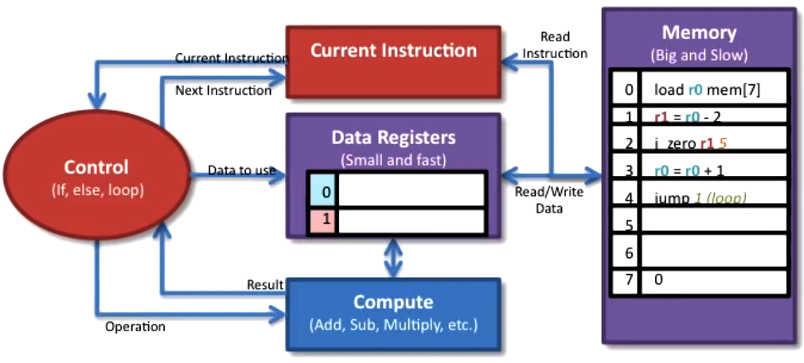
Walking through Program Execution
What will the processor do?

Slide 8
Walking through Program Execution
What will the processor do?
1. Load the instruction

Slide 9
Walking through Program Execution
What will the processor do?
1. Load the instruction
2. Figure out what operation to do

Slide 10
Walking through Program Execution
What will the processor do?
1. Load the instruction
2. Figure out what operation to do
3. Figure out what data to use

Slide 11
Walking through Program Execution
What will the processor do?
1. Load the instruction
2. Figure out what operation to do
3. Figure out what data to use
4. Do the computation

Slide 12
Walking through Program Execution
What will the processor do?
1. Load the instruction
2. Figure out what operation to do
3. Figure out what data to use
4. Do the computation
5. Figure out next instruction

Slide 13
Walking through Program Execution
What will the processor do?
1. Load the instruction
2. Figure out what operation to do
3. Figure out what data to use
4. Do the computation
5. Figure out next instruction
Repeat this over and over and over…

Slide 14
MIPS
MIPS (Microprocessor without Interlocked Pipelined Stages)
Simple, but greatly influenced later RISC architectures
In 2021 the development of the MIPS architecture had ended as the owner is making the transition to RISC-V
RISC-V: an open-source ISA
Very popular today …

Slide 15
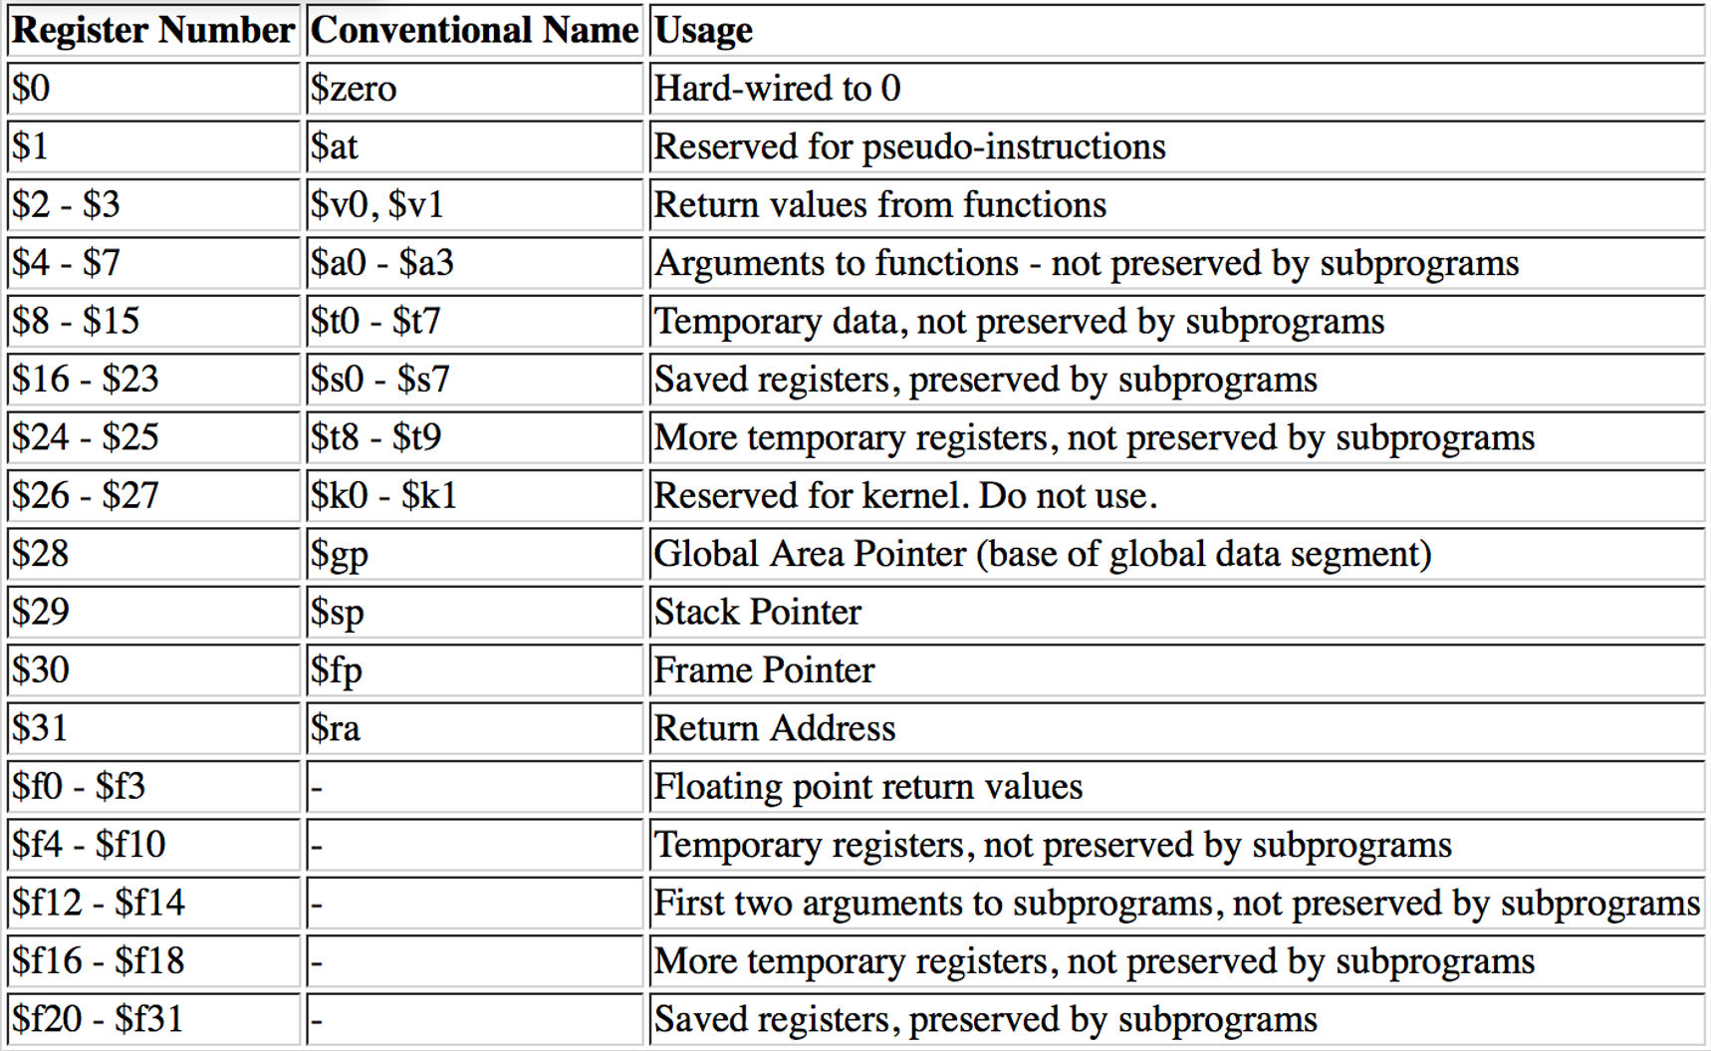
MIPS Registers
32 registers
Each register can be referred to by number $0, $1, … $30, $31 or by name, e.g., $t0 - $t7
Each MIPS register is 32 bits wide (one word)
32 D flip-flops

Slide 16
Memory and Register
MIPS is a Load/Store Register File machine
Instructions compute only on data in the Register File

Slide 17
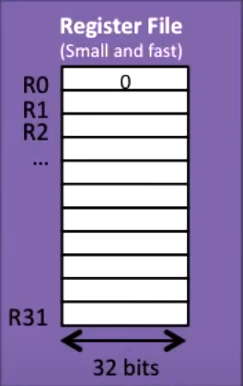
Memory and Register
MIPS is a Load/Store Register File machine
Instructions compute only on data in the Register File

Slide 18
Memory and Register
MIPS is a Load/Store Register File machine
Instructions compute only on data in the Register File
register: a multi-bit D Flip-Flop
register file: a set of registers

Slide 19
Memory and Register
MIPS is a Load/Store Register File machine
Instructions compute only on data in the Register File
Compute
(Add, Sub, Multiply, ect.)
register: a multi-bit D Flip-Flop
register file: a set of registers

Slide 20
Memory and Register
MIPS is a Load/Store Register File machine
Instructions compute only on data in the Register File
Example:
add R3, R2, R1
Compute
(Add, Sub, Multiply, ect.)
register: a multi-bit D Flip-Flop
register file: a set of registers

Slide 21
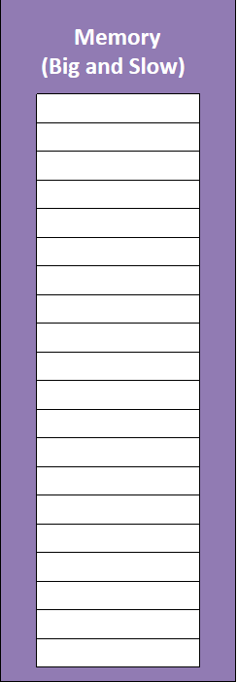
Memory and Register
MIPS is a Load/Store Register File machine
Instructions compute only on data in the Register File
Example:
add R3, R2, R1
But we only have 32 registers in the Register File
Not enough for a big program
Read/Write Data
Compute
(Add, Sub, Multiply, ect.)
register: a multi-bit D Flip-Flop
register file: a set of registers

Slide 22
Memory and Register
MIPS is a Load/Store Register File machine
Instructions compute only on data in the Register File
Example:
add R3, R2, R1
But we only have 32 registers in the Register File
Not enough for a big program
Most data is stored in memory (large, but slow)
Need to transfer the data to the Register File to use it
Read/Write Data
Compute
(Add, Sub, Multiply, ect.)
register: a multi-bit D Flip-Flop
register file: a set of registers

Slide 23
Memory and Register
MIPS is a Load/Store Register File machine
Instructions compute only on data in the Register File
Example:
add R3, R2, R1
But we only have 32 registers in the Register File
Not enough for a big program
Most data is stored in memory (large, but slow)
Need to transfer the data to the Register File to use it
Load: load data from memory to the Register File
Read/Write Data
Compute
(Add, Sub, Multiply, ect.)
register: a multi-bit D Flip-Flop
register file: a set of registers

Slide 24
Memory and Register
MIPS is a Load/Store Register File machine
Instructions compute only on data in the Register File
Example:
add R3, R2, R1
But we only have 32 registers in the Register File
Not enough for a big program
Most data is stored in memory (large, but slow)
Need to transfer the data to the Register File to use it
Load: load data from memory to the Register File
Store: store data to the memory from the register File
Read/Write Data
Compute
(Add, Sub, Multiply, ect.)
register: a multi-bit D Flip-Flop
register file: a set of registers

Slide 25
Memory Organization
Memory is a large 1-dimension array
Each location is one byte (8 bits)

Slide 26
Memory Organization
Memory
Memory is a large 1-dimension array
Each location is one byte (8 bits)
8 bits of data
8 bits of data
8 bits of data
8 bits of data
8 bits of data
8 bits of data
8 bits of data
8 bits of data
8 bits of data
8 bits of data
8 bits of data
8 bits of data
8 bits of data
8 bits of data
8 bits of data
8 bits of data
8 bits

Slide 27
Memory Organization
Memory
Memory is a large 1-dimension array
Each location is one byte (8 bits)
A memory address indexes into the array
Address
4,294,967,295
(=2³² - 1)
8 bits of data
8 bits of data
8 bits of data
8 bits of data
8 bits of data
8 bits of data
8 bits of data
8 bits of data
8 bits of data
8 bits of data
8 bits of data
8 bits of data
8 bits of data
8 bits of data
8 bits of data
8 bits of data
…
2
1
0
8 bits

Slide 28
Memory Organization
Memory
Memory is a large 1-dimension array
Each location is one byte (8 bits)
A memory address indexes into the array
For a 32-bit computer, there are 2³² memory locations (4GB)
Address
4,294,967,295
(=2³² - 1)
8 bits of data
8 bits of data
8 bits of data
8 bits of data
8 bits of data
8 bits of data
8 bits of data
8 bits of data
8 bits of data
8 bits of data
8 bits of data
8 bits of data
8 bits of data
8 bits of data
8 bits of data
8 bits of data
…
2
1
0
8 bits

Slide 29
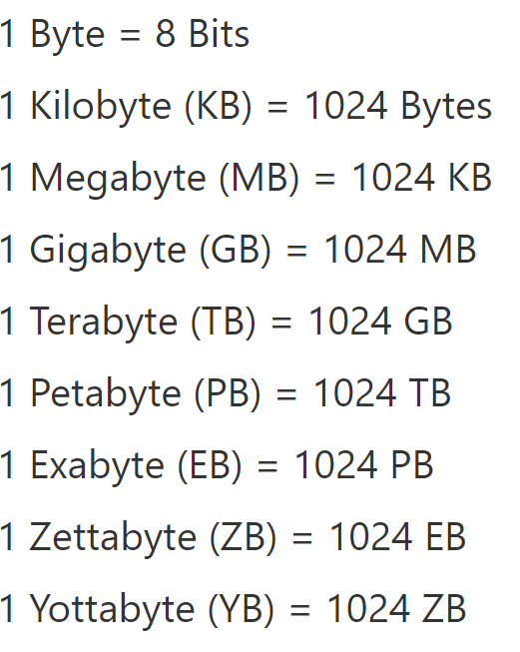
Memory Organization
Memory
Memory is a large 1-dimension array
Each location is one byte (8 bits)
A memory address indexes into the array
For a 32-bit computer, there are 2³² memory locations (4GB)
For a 64-bit computer, there are 2⁶⁴ memory locations (16EB)
64-bit x86 machines tend to be limited to ~48-bits of
address space, or 4PB.
Address
4,294,967,295
(=2³² - 1)
8 bits of data
8 bits of data
8 bits of data
8 bits of data
8 bits of data
8 bits of data
8 bits of data
8 bits of data
8 bits of data
8 bits of data
8 bits of data
8 bits of data
8 bits of data
8 bits of data
8 bits of data
8 bits of data
…
Good to know, but don’t need
to remember
2
1
0
8 bits

Slide 30
Viewing Memory as Bytes or Words
Byte-addressable
view of memory
…
6
5
4
3
2
1
0
8 bits of data
8 bits of data
8 bits of data
8 bits of data
8 bits of data
8 bits of data
8 bits of data
Byte Address
1 byte = 8 bits

Slide 31
Viewing Memory as Bytes or Words
Byte-addressable
view of memory
Most data in MIPS is handled in words not bytes
A word is 32 bits or 4 bytes
A word is the size of a register
…
6
5
4
3
2
1
0
8 bits of data
8 bits of data
8 bits of data
8 bits of data
8 bits of data
8 bits of data
8 bits of data
Byte Address
1 byte = 8 bits
Notes:
however is we just said most data and MIPS is handled in words not bytes so we need to put four of these together if we want to handle it and we've seen examples of where we use these words or 32 bits of data registers and addresses are both one word so now let's take a look at memory in a slightly different view we're going to look at the same data as we had here but now we're going to look at it as word aligned data

Slide 32
Viewing Memory as Bytes or Words
Byte-addressable
view of memory
Word-aligned
view of memory
Most data in MIPS is handled in words not bytes
A word is 32 bits or 4 bytes
A word is the size of a register
…
6
5
4
3
2
1
0
8 bits of data
8 bits of data
8 bits of data
8 bits of data
8 bits of data
8 bits of data
8 bits of data
Byte Address
1 byte = 8 bits

Slide 33
Viewing Memory as Bytes or Words
Byte-addressable
view of memory
Word-aligned
view of memory
Most data in MIPS is handled in words not bytes
A word is 32 bits or 4 bytes
A word is the size of a register
…
6
5
4
3
2
1
0
8 bits of data
8 bits of data
8 bits of data
8 bits of data
8 bits of data
8 bits of data
8 bits of data
Byte Address
0
8 bits of data
8 bits of data
8 bits of data
8 bits of data
1 word = 4 bytes = 32 bits of data
Register hold 32 bits of data (1 word)
Addresses are 32 bits of data (1 word)
1 byte = 8 bits

Slide 34
Viewing Memory as Bytes or Words
Byte-addressable
view of memory
Word-aligned
view of memory
Most data in MIPS is handled in words not bytes
A word is 32 bits or 4 bytes
A word is the size of a register
…
…
6
5
4
3
2
1
0
8 bits of data
8 bits of data
8 bits of data
8 bits of data
8 bits of data
8 bits of data
8 bits of data
12
8 bits of data
8 bits of data
8 bits of data
8 bits of data
Byte Address
8
8 bits of data
8 bits of data
8 bits of data
8 bits of data
4
8 bits of data
8 bits of data
8 bits of data
8 bits of data
0
8 bits of data
8 bits of data
8 bits of data
8 bits of data
1 word = 4 bytes = 32 bits of data
Register hold 32 bits of data (1 word)
Addresses are 32 bits of data (1 word)
1 byte = 8 bits

Slide 35
Viewing Memory as Bytes or Words
Byte-addressable
view of memory
Word-aligned
view of memory
Most data in MIPS is handled in words not bytes
A word is 32 bits or 4 bytes
A word is the size of a register
…
…
6
5
4
3
2
1
0
8 bits of data
8 bits of data
8 bits of data
8 bits of data
8 bits of data
8 bits of data
8 bits of data
12
8 bits of data
8 bits of data
8 bits of data
8 bits of data
Byte Address
8
8 bits of data
8 bits of data
8 bits of data
8 bits of data
4
8 bits of data
8 bits of data
8 bits of data
8 bits of data
0
8 bits of data
8 bits of data
8 bits of data
8 bits of data
1 word = 4 bytes = 32 bits of data
Register hold 32 bits of data (1 word)
Addresses are 32 bits of data (1 word)
1 byte = 8 bits
Loading 1 word now fills a register!
Notes:
so the benefit of doing this is now if we load a word aligned address we can load a full word of data directly into the register which is great because our registers take a full word

Slide 36
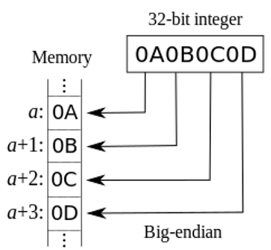
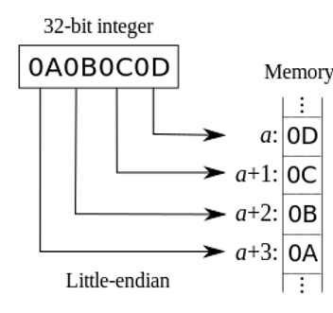
Big- and Little-Endian Addressing
Two ways to assign byte address across words
Big-endian addressing assigns lower addresses to more significant (leftmost) bytes of word
Little-endian addressing uses opposite order
MIPS can support both
Notes:
An ISA uses either approach, and some can support both approaches

Slide 37
Access alignment
Aligned addresses fall on 4 byte (word) boundaries (e.g., 0, 4, 8, 12…)
Unaligned addresses do not (e.g., 1, 3, 7, 63)
MIPS uses Aligned addresses
Some ISA support unaligned accesses
Hardware can convert to multiple aligned accesses (complex)
Hardware can detect it and have software to fix it (slow)
there’s typically a performance penalty
…
Example of aligned vs. unaligned access
Load Word at addr=9 not Aligned
12
8 bits of data
8 bits of data
8 bits of data
8 bits of data
8
8 bits of data
8 bits of data
8 bits of data
8 bits of data
Load Word at addr=0 Aligned
4
8 bits of data
8 bits of data
8 bits of data
8 bits of data
0
8 bits of data
8 bits of data
8 bits of data
8 bits of data

Slide 38
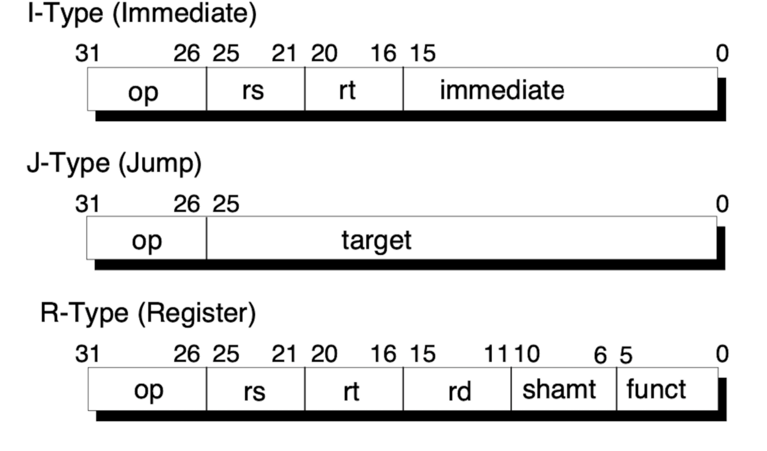
MIPS Instructions
32-bit long (a word)
a word is 32 bits (4 bytes) in MIPS
3 types:
I-Type (I-Format)
J-Type (J-Format)
R-Type (R-Format)
Simple and Regular

Slide 39
MIPS Instructions
opcode
Opcode: representation of the instruction
Several related instructions can have the same opcode
In R-Type, opcode + shamt/funct together decide the operation
6 bits long (bit 26 to bit 31)
R-type/I-type have 3 operands
J-type has 1 operand
operands

Slide 40
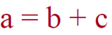
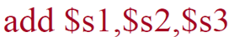
MIPS Instructions
Operands are stored in registers in MIPS
Most Instructions have 3 operands (R-type and I-type)
Format: Op_name dest, src1, src2
Op_name: operation name
Dest: operand getting result (“destination”)
Src1: 1st operand for operation (“source1”)
Src2: 2nd operand for operation (“source2”)
Example
C code:
MIPS code:
(add a, b, c)

Slide 41
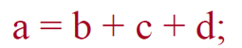
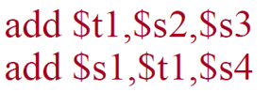
MIPS Instructions
Each line of assembly code contains at most 1 instruction
Hash (#) is used for comments
C code:
(add x, b, c)
MIPS code:
(add a, x, d)
add $s1,$s2,$s3 #this is my comment

Slide 42
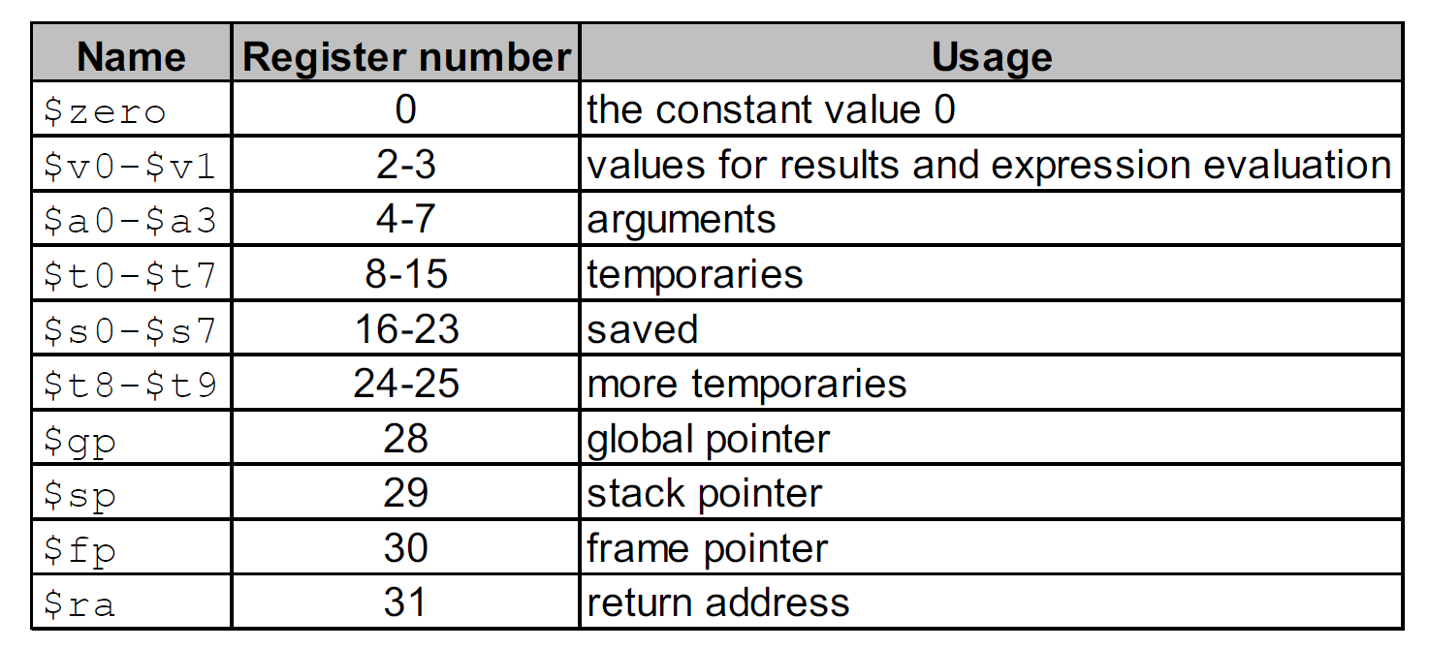
Symbols
#: denote immediate number
add $s1, $s2, #10 ($s1=$s2+10)
some compilers omit #, so you can write add $s1, $s2, 10
immediate number and comment can be distinguished automatically
$: denote register
$10: the tenth register
$t0: register t0

Slide 43
MIPS Directives
Commands to the assembler, specifying an action to be taken in the assembly process
declaring or reserving memory variables
break up the program into “data” and “instruction” sections
… …
Directive | Operand Syntax | Meaning
.global | label { , label }* | Declare labels to be global
.data | none | Start a data declaration section
.text | none | Start an instruction section
.byte | character [ : non-negative integer ] | Declare a character or byte variable
.word | integer [ : non-negative integer ] | Declare a C int variable
.float | real number [ : non-negative integer ] | Declare a C float variable
.double | real number [ : non-negative integer ] | Declare a C double variable
.asciiz | string | Declare a string variable
.space | non-negative integer | Reserve memory space

Slide 44
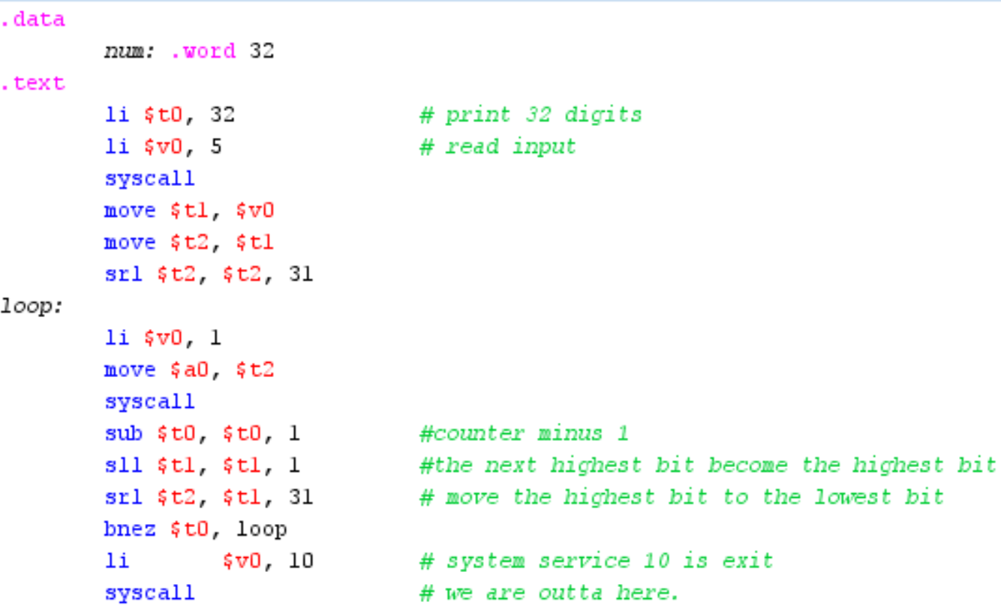
Labels
Each label represents a memory address in assembly language
It could be the address of data or the address of an instruction
Example

Slide 45
MIPS Instruction Set
Data operations
Arithmetic (add, sub, mul, div)
Logical (and, or)
Data transfer
Load (memory -> register)
Save (register->memory)
Control
Conditional Branch (like “if … then … else” in C)
Unconditional Branch (like “goto” in C)

Slide 46
MIPS Instruction Set
In this course, we do not aim to enumerate all MIPS instructions
We aim to
be able to use basic instructions
understand the principle
You don’t need to remember the instruction names and formats exactly, but should
be able to understand how to use it if the name & format are given
In HW, you can check the manual (available on Canvas) or google
In the exam, the name and format of the instruction will be given

Slide 47
MIPS Instruction Set
Data operations
Arithmetic (add, sub, mul, div)
Logical (and, or)
Data transfer
Load (memory -> register)
Save (register->memory)
Control
Conditional Branch (like “if … then … else” in C)
Unconditional Branch (like “goto” in C)

Slide 48
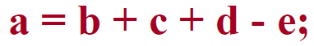
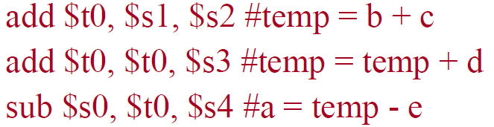
Data Operation Instructions
How to do the following C statement?
Suppose the following register mapping
Break into multiple instructions
A single line of C code may break up into several lines of MIPS code
May need to use temporary registers ($t0 - $t9) for intermediate results

Slide 49
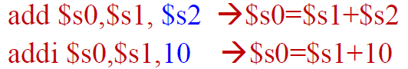
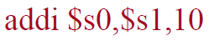
Immediate Number
Some instructions use immediate number (constant) as operands
Add immediate number
C code : f = g + 10
MIPS code:
Syntax similar to add, but last operand is a number instead of a register
add is R-format
addi is I-format

Slide 50
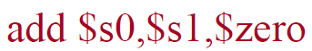
Register Zero
One particular immediate number, the number zero (0), appears very often in code
Register zero ($0 or $zero) always have value 0
E.g., often used for value assignment
C code: f = g;
f = g + 0;
MIPS code:
Note: $zero is wired in hardware, its value cannot change

Slide 51
Multiplication and Division
Multiplication and division require to use two special purpose registers, the hi and lo registers.
not included in the 32 MIPS registers
not directly under programmer control
Multiplication is more complicated than addition because the result can require twice as many digits as the input values
99x99=9801 (2 two-digit numbers yield a four-digit number)
Division (integer) is more complicated because the result has two parts: quotient and remainder

Slide 52
Multiplication and Division
mult $s0, $s1
stores the result in the [hi, lo] register pair
high bits stored in hi and low bits stored in lo
div $s0, $s1 (s0 divided by s1)
stores the result in the [hi, lo] register pair
quotient in the lo and the remainder in the hi
mfhi $s0
moves the value from the hi register into the s0 register
mflo $s0
moves the value from the lo register into the s0 register
There are other formats of multiplication and division instructions in MIPS, but we will not discuss them.

Slide 53
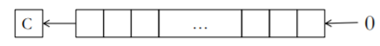
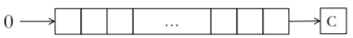
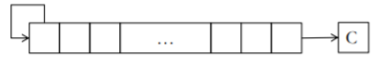
Shifts
sll – logical shift left by n bits – multiplication by 2^{n}
srl – logical shift right by n bits–unsigned division by 2^{n}
sra – arithmetic shift right by n bits – signed division by 2^{n}

Slide 54
Move
move $s1, $s2
Move from register $s2 to another register $s1
This is a pseudo-instruction, which is implemented as
addu $t0, $zero, $s0
(we will talk about pseudo-instruction later)

Slide 55
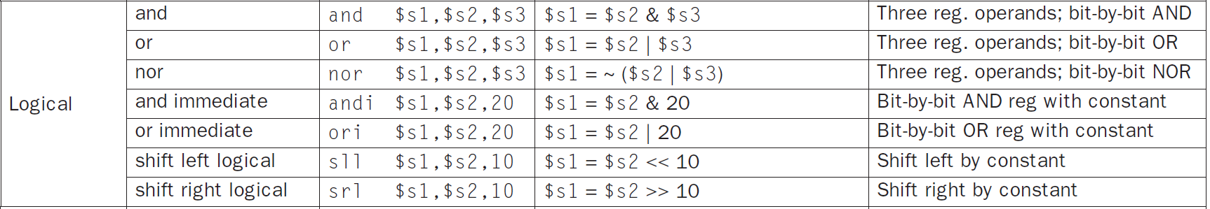
Some Data Operation Instruction

Slide 56
Data Operations in Details
Program Counter (PC)
1. Program Counter (PC) holds
the instruction address.
Memory
Register File
Instruction address
0
4
8
12
16
20
24
28
32
R0 | 0
R1
R2
R3
R4
R5
R6
R7
R8
ALU
ALU: Arithmetic Logic Unit

Slide 57
Data Operations in Details
Program Counter (PC)
1. Program Counter (PC) holds
the instruction address.
2. Instructions are fetched
from memory
Memory
Register File
Instruction address
0
4
8
12
16
20
24
28
32
R0 | 0
R1
R2
R3
R4
R5
R6
R7
R8
Instruction
Current instruction
ALU

Slide 58
Data Operations in Details
Program Counter (PC)
1. Program Counter (PC) holds
the instruction address.
2. Instructions are fetched
from memory
3. Control logic decodes the
instruction and tells the ALU
and Register File what to do
Memory
Register File
Instruction address
0
4
8
12
16
20
24
28
32
R0 | 0
R1
R2
R3
R4
R5
R6
R7
R8
Instruction
Current instruction
Control
Logic
ALU
Notes:
the current instruction is then decoded by some control logic and the control logics job is to look at the current instruction and tell the rest of the processor what to dodsfddsafds

Slide 59
Data Operations in Details
Program Counter (PC)
1. Program Counter (PC) holds
the instruction address.
2. Instructions are fetched
from memory
3. Control logic decodes the
instruction and tells the ALU
and Register File what to do
Memory
Register File
Instruction address
0
4
8
12
16
20
24
28
32
R0 | 0
R1
R2
R3
R4
R5
R6
R7
R8
Instruction
Current instruction
Control
Logic
ALU

Slide 60
Data Operations
Program Counter (PC)
1. Program Counter (PC) holds
the instruction address.
2. Instructions are fetched
from memory
3. Control logic decodes the
instruction and tells the ALU
and Register File what to do
4. ALU executes the instruction
using data get from Register
File and results flow back to
the Register File
Memory
Register File
Instruction address
0
4
8
12
16
20
24
28
32
R0 | 0
R1
R2
R3
R4
R5
R6
R7
R8
Instruction
Current instruction
Control
Logic
ALU

Slide 61
Data Operations
Program Counter (PC)
1. Program Counter (PC) holds
the instruction address.
2. Instructions are fetched
from memory
3. Control logic decodes the
instruction and tells the ALU
and Register File what to do
4. ALU executes the instruction
using data get from Register
File and results flow back to
the Register File
5. The Control logic updates
the Program Counter for the
next instruction.
Memory
Register File
Instruction address
0
4
8
12
16
20
24
28
32
R0 | 0
R1
R2
R3
R4
R5
R6
R7
R8
Instruction
Current instruction
Control
Logic
ALU

Slide 62
Add/Sub Example
Program Counter (PC)
Memory
Register File
0 | add R4, R0, R0
4 | sub R1, R3, R4
8
12
16
20
24
28
32
R0 | 0
R1
R2
R3
R4
R5
R6
R7
R8
Instruction
Control
Logic
ALU

Slide 63
Add/Sub Example
Program Counter (PC)
Memory
Register File
0 | add R4, R0, R0
4 | sub R1, R3, R4
8
12
16
20
24
28
32
R0 | 0
R1
R2
R3 | 6
R4 | 4
R5
R6
R7
R8
Instruction
Control
Logic
ALU

Slide 64
Add/Sub Example
Program Counter (PC)
Memory
Register File
0
0 | add R4, R0, R0
4 | sub R1, R3, R4
8
12
16
20
24
28
32
R0 | 0
R1
R2
R3 | 6
R4 | 4
R5
R6
R7
R8
Instruction
add R4, R0, R0
Control
Logic
ALU

Slide 65
Add/Sub Example
Program Counter (PC)
Memory
Register File
0
0 | add R4, R0, R0
4 | sub R1, R3, R4
8
12
16
20
24
28
32
R0 | 0
R1
R2
R3 | 6
R4 | 4
R5
R6
R7
R8
Instruction
add R4, R0, R0
Control
Logic
ALU
add

Slide 66
Add/Sub Example
Program Counter (PC)
Memory
Register File
0
0 | add R4, R0, R0
4 | sub R1, R3, R4
8
12
16
20
24
28
32
R0 | 0
R1
R2
R3 | 6
R4 | 4
R5
R6
R7
R8
Instruction
add R4, R0, R0
Control
Logic
ALU
add

Slide 67
Add/Sub Example
Program Counter (PC)
Memory
Register File
0
0 | add R4, R0, R0
4 | sub R1, R3, R4
8
12
16
20
24
28
32
R0 | 0
R1
R2
R3 | 6
R4 | 0
R5
R6
R7
R8
Instruction
add R4, R0, R0
Control
Logic
ALU
add

Slide 68
Add/Sub Example
Program Counter (PC)
Memory
Register File
4
0 | add R4, R0, R0
4 | sub R1, R3, R4
8
12
16
20
24
28
32
R0 | 0
R1
R2
R3 | 6
R4 | 0
R5
R6
R7
R8
Instruction
add R4, R0, R0
Control
Logic
ALU
add

Slide 69
Add/Sub Example
Program Counter (PC)
Memory
Register File
4
0 | add R4, R0, R0
4 | sub R1, R3, R4
8
12
16
20
24
28
32
R0 | 0
R1
R2
R3 | 6
R4 | 0
R5
R6
R7
R8
Instruction
sub R1, R3, R4
Control
Logic
ALU
Notes:
so now we do the same thing again our program counter says instruction 4 so we're going to load instruction 4 from the memory into the instruction register

Slide 70
Add/Sub Example
Program Counter (PC)
Memory
Register File
4
0 | add R4, R0, R0
4 | sub R1, R3, R4
8
12
16
20
24
28
32
R0 | 0
R1
R2
R3 | 6
R4 | 0
R5
R6
R7
R8
Instruction
sub R1, R3, R4
Control
Logic
ALU
sub
Notes:
it's going to go into the control tell the ALU what to do in this case it's going to be a subtraction and tell the register file which data to use

Slide 71
Add/Sub Example
Program Counter (PC)
Memory
Register File
4
0 | add R4, R0, R0
4 | sub R1, R3, R4
8
12
16
20
24
28
32
R0 | 0
R1
R2
R3 | 6
R4 | 0
R5
R6
R7
R8
Instruction
sub R1, R3, R4
Control
Logic
ALU
sub
Notes:
in this case we're going to use registers 3 & 4 and store them into register 1 so registers 3 & 4 and store them into register 1

Slide 72
Add/Sub Example
Program Counter (PC)
Memory
Register File
4
0 | add R4, R0, R0
4 | sub R1, R3, R4
8
12
16
20
24
28
32
R0 | 0
R1 | 6
R2
R3 | 6
R4 | 0
R5
R6
R7
R8
Instruction
sub R1, R3, R4
Control
Logic
ALU
sub
Notes:
go ahead and do the computation and update register 1 now the last part is the control to say which instruction to go on to

Slide 73
Question: Incrementing the PC
Program Counter (PC)
Q: How much does the Program Counter increment to go to the next instruction?
1 byte
4 byte
4 words
Memory
Register File
0 | add R4, R0, R0
4 | sub R1, R3, R4
8
12
16
20
24
28
32
R0 | 0
R1
R2
R3
R4
R5
R6
R7
R8
Instruction
Control
Logic
ALU

Slide 74
Question: Incrementing the PC
Program Counter (PC)
Q: How much does the Program Counter increment to go to the next instruction?
1 byte
4 byte
4 words
Memory
Register File
0 | add R4, R0, R0
4 | sub R1, R3, R4
8
12
16
20
24
28
32
R0 | 0
R1
R2
R3
R4
R5
R6
R7
R8
Instruction
A: 4 bytes
Each instruction is one word or 32 bits, so the program counter needs to move 32 bits ahead for each instruction. Since the memory is byte-addressable, we increment the address by 4 bytes (4 bytes = 32 bits = 1 word, 8 bits per byte)
Control
Logic
ALU

Slide 75
Question: Incrementing the PC
Program Counter (PC)
Q: How much does the Program Counter increment to go to the next instruction?
1 byte
4 byte
4 words
Memory
Register File
4
0 | add R4, R0, R0
4 | sub R1, R3, R4
8
12
16
20
24
28
32
R0 | 0
R1
R2
R3
R4
R5
R6
R7
R8
Instruction
add R4, R0, R0
A: 4 bytes
Each instruction is one word or 32 bits, so the program counter needs to move 32 bits ahead for each instruction. Since the memory is byte-addressable, we increment the address by 4 bytes (4 bytes = 32 bits = 1 word, 8 bits per byte)
Control
Logic
ALU

Slide 76
Question: Incrementing the PC
Program Counter (PC)
Q: How much does the Program Counter increment to go to the next instruction?
1 byte
4 byte
4 words
Memory
Register File
4
0 | add R4, R0, R0
4 | sub R1, R3, R4
8
12
16
20
24
28
32
R0 | 0
R1
R2
R3
R4
R5
R6
R7
R8
Instruction
sub R1, R3, R4
A: 4 bytes
Each instruction is one word or 32 bits, so the program counter needs to move 32 bits ahead for each instruction. Since the memory is byte-addressable, we increment the address by 4 bytes (4 bytes = 32 bits = 1 word, 8 bits per byte)
Control
Logic
ALU
Notes:
the next instruction we need to go on to address 4 to get the next 4 bytes and execute them

Slide 77
Question: Incrementing the PC
Program Counter (PC)
Q: How much does the Program Counter increment to go to the next instruction?
1 byte
4 byte
4 words
Memory
Register File
4
0 | add R4, R0, R0
4 | sub R1, R3, R4
8
12
16
20
24
28
32
R0 | 0
R1
R2
R3
R4
R5
R6
R7
R8
Instruction
sub R1, R3, R4
A: 4 bytes
Each instruction is one word or 32 bits, so the program counter needs to move 32 bits ahead for each instruction. Since the memory is byte-addressable, we increment the address by 4 bytes (4 bytes = 32 bits = 1 word, 8 bits per byte)
Control
Logic
ALU
Instruction addresses are word-aligned(multiple of 4) because instructions are 1 word long.

Slide 78
Question: Controlling The Register File
Program Counter (PC)
Q: Where does the Register File get the information on which registers to read and write from?
Memory
Register File
0 | add R4, R0, R0
4 | sub R1, R3, R4
8
12
16
20
24
28
32
R0 | 0
R1
R2
R3
R4
R5
R6
R7
R8
Instruction
Control
Logic
ALU

Slide 79
Question: Controlling The Register File
Program Counter (PC)
Q: Where does the Register File get the information on which registers to read and write from?
Memory
Register File
0 | add R4, R0, R0
4 | sub R1, R3, R4
8
12
16
20
24
28
32
R0 | 0
R1
R2
R3
R4
R5
R6
R7
R8
Instruction
Control
Logic
ALU
A: From the Control
The control logic decodes the instruction and figures out which register file entries to use. It then tells the Register File what to read and write.

Slide 80
Question: Controlling The Register File
Program Counter (PC)
Q: Where does the Register File get the information on which registers to read and write from?
Memory
Register File
0
0 | add R4, R0, R0
4 | sub R1, R3, R4
8
12
16
20
24
28
32
R0 | 0
R1
R2
R3
R4
R5
R6
R7
R8
Instruction
add R4, R0, R0
Control
Logic
ALU
A: From the Control
The control logic decodes the instruction and figures out which register file entries to use. It then tells the Register File what to read and write.
add
Notes:
so here in this example if we're looking at instruction 0 it's going to take instruction 0 it's going to tell the ALU to the audition and it's going to tell the register file to access the two registers and then finally it sent all the register file which register to write back to so the control decodes the instruction and tells the rest of the processor what to do

Slide 81
MIPS Instruction Set
Data operations
Arithmetic (add, sub, mul, div)
Logical (and, or)
Data transfer
Load (memory -> register)
Save (register->memory)
Control
Conditional Branch (like “if … then … else” in C)
Unconditional Branch (like “goto” in C)

Slide 82
Data Transfer Instructions
In MIPS (and other typical RISC), calculations require to:
Get operands from memory into registers
Calculations performed only on values in registers
Write result from register back to memory
Only Load instructions can read an operand from memory
Only Store instructions can write an operand to memory

Slide 83
Load and Store
$s1
xxxx
lw: load a word from memory to register
Example: lw $s1, 100($t1)
Register $s1 = content of memory location (100 + $t1)
sw: store a word from register to memory
Example: sw $s1, 100($t1)
Content of memory location (100 + $t1) = Register $s1
In both cases, $t1 is base register, and 100 is offset
$t1
2000
100
xxxx
2100
+
$s1
yyyy
$t1
2000
100
yyyy
2100
+

Slide 84
Load Immediate and Address
li: load Immediate to register
Example: li $s1, 100
Load immediate 100 to $s1
la: load address to register
Example: la $s1, label
$s1= the address of label

Slide 85
Data Transfers
Register File
Program Counter (PC)
Memory
R0 | 0
R1
R2
R3
R4
R5
R6
R7
R8
0
4
8
12
16
20
24 | 323
28
32
Instruction
Control
Logic
ALU

Slide 86
Data Transfers
Register File
Program Counter (PC)
1. ALU generates address
Memory
R0 | 0
R1
R2
R3
R4
R5
R6
R7
R8
0
4
8
12
16
20
24 | 323
28
32
Instruction
Control
Logic
ALU
24

Slide 87
Data Transfers
Register File
Program Counter (PC)
1. ALU generates address
2. Address goes to the
Memory Address Register
Memory
R0 | 0
R1
R2
R3
R4
R5
R6
R7
R8
0
4
8
12
16
20
24 | 323
28
32
Instruction
Control
Logic
ALU
Memory Address
24
Data address
24
Notes:
so we can get it to the memory so what we're going to do is we're going to add a memory address register and

Slide 88
Data Transfers
Register File
Program Counter (PC)
1. ALU generates address
2. Address goes to the
Memory Address Register
Memory
R0 | 0
R1
R2
R3
R4
R5
R6
R7
R8
0
4
8
12
16
20
24 | 323
28
32
Instruction
Control
Logic
ALU
Memory Address
24
24
Data address

Slide 89
Data Transfers
Register File
Program Counter (PC)
1. ALU generates address
2. Address goes to the
Memory Address Register
3. Results to/from memory
are stored in the Memory
Data Register
Memory
R0 | 0
R1
R2
R3
R4
R5
R6
R7
R8
0
4
8
12
16
20
24 | 323
28
32
Instruction
Control
Logic
ALU
Memory Address
24
24
Data address
Data
Data

Slide 90
Data Transfers
Register File
Program Counter (PC)
1. ALU generates address
2. Address goes to the
Memory Address Register
3. Results to/from memory
are stored in the Memory
Data Register
Memory
R0 | 0
R1
R2
R3
R4
R5
R6
R7
R8
0
4
8
12
16
20
24 | 323
28
32
Instruction
Control
Logic
ALU
Memory Address
24
24
Data address
Data
323
Notes:
so if I'm using that address to access memory I can put the data I got into that register

Slide 91
Data Transfers
Register File
Program Counter (PC)
1. ALU generates address
2. Address goes to the
Memory Address Register
3. Results to/from memory
are stored in the Memory
Data Register
4. Data from memory can
now be stored back into
the Register File or to
memory can be written.
Memory
R0 | 0
R1
R2 | 323
R3
R4
R5
R6
R7
R8
0
4
8
12
16
20
24 | 323
28
32
Instruction
Control
Logic
ALU
Memory Address
24
24
Data address
Data
323

Slide 92
Load Word
Register File
Program Counter (PC)
Memory
R0 | 0
R1
R2
R3
R4
R5
R6
R7
R8
0
0 | addi R5, R0, 12
4 | lw R6, R5
8
12 | 123456789
16
20
24
28
32
Instruction
Control
Logic
ALU
Memory Address
Data

Slide 93
Load Word
Register File
Program Counter (PC)
Memory
R0 | 0
R1
R2
R3
R4
R5
R6
R7
R8
0
0 | addi R5, R0, 12
4 | lw R6, R5
8
12 | 123456789
16
20
24
28
32
Instruction
Control
Logic
ALU
Memory Address
Data

Slide 94
Load Word
Register File
Program Counter (PC)
Memory
R0 | 0
R1
R2
R3
R4
R5 | 12
R6
R7
R8
0
0 | addi R5, R0, 12
4 | lw R6, R5
8
12 | 123456789
16
20
24
28
32
Instruction
addi R5, R0, 12
Control
Logic
ALU
Memory Address
add
Data
Notes:
so let's take a look at this program so we start out with instruction 0 we move it into our instruction register and our control tells our ALU do an ADD it's an add instruction and the register file what data to use now this is an ADD immediate instruction so we're going to get some of the data from our 0 here but we also need some data from this 12 so I take some of the data from 0 and some of the data directly from the instruction so that 12 is in the instruction we're going to send that 12 right down to the ALU. we add those together and we right back into r5 and right into 12

Slide 95
Load Word
Register File
Program Counter (PC)
Memory
R0 | 0
R1
R2
R3
R4
R5 | 12
R6
R7
R8
4
0 | addi R5, R0, 12
4 | lw R6, R5
8
12 | 123456789
16
20
24
28
32
Instruction
addi R5, R0, 12
Control
Logic
ALU
Memory Address
add
Data

Slide 96
Load Word
Register File
Program Counter (PC)
Memory
R0 | 0
R1
R2
R3
R4
R5 | 12
R6
R7
R8
4
0 | addi R5, R0, 12
4 | lw R6, R5
8
12 | 123456789
16
20
24
28
32
Instruction
lw R6, R5
Control
Logic
ALU
Memory Address
Pass through
12
Data

Slide 97
Load Word
Register File
Program Counter (PC)
Memory
R0 | 0
R1
R2
R3
R4
R5 | 12
R6 | 123456789
R7
R8
4
0 | addi R5, R0, 12
4 | lw R6, R5
8
12 | 123456789
16
20
24
28
32
Instruction
lw R6, R5
Control
Logic
ALU
Memory Address
Pass through
12
Data
123456789

Slide 98
Load Word
Register File
Program Counter (PC)
We used the
address from
the register
file to load data
from memory.
Memory
R0 | 0
R1
R2
R3
R4
R5 | 12
R6 | 123456789
R7
R8
4
0 | addi R5, R0, 12
4 | lw R6, R5
8
12 | 123456789
16
20
24
28
32
Instruction
lw R6, R5
Control
Logic
ALU
Memory Address
Pass through
12
Data
123456789

Slide 99
Load Word with Offset
Register File
Program Counter (PC)
An offset can
be added to
addresses as
part of the lw/sw
instructions.
lw R6, 4(R5)
Memory
R0 | 0
R1
R2
R3
R4
R5 | 12
R6
R7
R8
4
0 | addi R5, R0, 12
4 | lw R6, 4(R5)
8
12 | 123456789
16 | 999999999
20
24
28
32
Instruction
Control
Logic
ALU
Memory Address
Data

Slide 100
Load Word with Offset
Add 4 bytes to the address in R5
Register File
Program Counter (PC)
An offset can
be added to
addresses as
part of the lw/sw
instructions.
lw R6, 4(R5)
Memory
R0 | 0
R1
R2
R3
R4
R5 | 12
R6
R7
R8
4
0 | addi R5, R0, 12
4 | lw R6, 4(R5)
8
12 | 123456789
16 | 999999999
20
24
28
32
Instruction
Control
Logic
ALU
Memory Address
Data

Slide 101
Load Word with Offset
Add 4 bytes to the address in R5
Register File
Program Counter (PC)
An offset can
be added to
addresses as
part of the lw/sw
instructions.
lw R6, 4(R5)
Memory
R0 | 0
R1
R2
R3
R4
R5 | 12
R6
R7
R8
4
0 | addi R5, R0, 12
4 | lw R6, 4(R5)
8
12 | 123456789
16 | 999999999
20
24
28
32
Instruction
lw R6, 4(R5)
Control
Logic
ALU
Memory Address
add
16
Data

Slide 102
Load Word with Offset
Add 4 bytes to the address in R5
Register File
Program Counter (PC)
An offset can
be added to
addresses as
part of the lw/sw
instructions.
lw R6, 4(R5)
Memory
R0 | 0
R1
R2
R3
R4
R5 | 12
R6 | 999999999
R7
R8
4
0 | addi R5, R0, 12
4 | lw R6, 4(R5)
8
12 | 123456789
16 | 999999999
20
24
28
32
Instruction
lw R6, 4(R5)
Control
Logic
ALU
Memory Address
add
16
Data
999999999
Notes:
now we're gonna do the load we're gonna go and access the memory at location 16 and we're gonna load it into our data register and then finally write it back into our register file so at this point you should notice a similarity between the load word instruction with the constant offset and the add I instruction with the constant offset and indeed we'll talk about that similarity in the next lecture when we talk about instruction encodings

Slide 103
Store Word
Register File
Program Counter (PC)
For stores we
need:
Memory
R0 | 0
R1
R2
R3
R4
R5 | 12
R6 | 31415
R7
R8
4
0 | addi R5, R0, 12
4 | sw R6, R5
8
12
16
20
24
28
32
Instruction
Control
Logic
ALU
Memory Address
Data

Slide 104
Store Word
Register File
Program Counter (PC)
For stores we
need:
the address
(from ALU)
the data
(from register)
Memory
R0 | 0
R1
R2
R3
R4
R5 | 12
R6 | 31415
R7
R8
4
0 | addi R5, R0, 12
4 | sw R6, R5
8
12
16
20
24
28
32
Instruction
Control
Logic
ALU
Memory Address
Data

Slide 105
Store Word
Register File
Program Counter (PC)
For stores we
need:
the address
(from ALU)
the data
(from register)
Memory
R0 | 0
R1
R2
R3
R4
R5 | 12
R6 | 31415
R7
R8
4
0 | addi R5, R0, 12
4 | sw R6, R5
8
12 | 31412
16
20
24
28
32
Instruction
sw R6, R5
Control
Logic
ALU
Memory Address
Pass through
12
Data
31415

Slide 106
MIPS Instruction Set
Data operations
Arithmetic (add, sub, mul, div)
Logical (and, or)
Data transfer
Load (memory -> register)
Save (register->memory)
Control
Conditional Branch (like “if … then … else” in C)
Unconditional Branch (like “goto” in C)

Slide 107
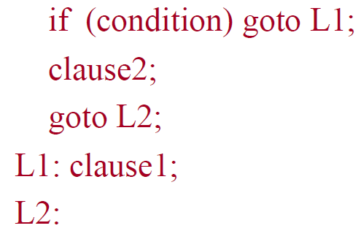
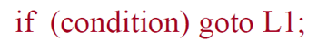
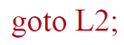
C Decisions: IF Statements
IF statements in C
if (condition) clause1 else clause2
Rearrange if-else using goto and labels into:
Not as elegant as if-else, but the same meaning
We need two types of branching
Conditional branch
Unconditional jump

Slide 108
Conditional Branch
beq is “branch if equal”
beq $s1, $s2, Label
If $s1 = $s2, jump to Label
beq $s1, $s2, 100
If $s1 = $s2, jump to PC+4+400
the unit of “100” is word, so need to convert to 400 bytes
“+ 4” because PC already points to the next instruction when executing this one
bne is “branch if not equal”, similar

Slide 109
Conditional Branch
bnez is “branch if not equal zero”
bnez $s1, Label (i.e., bne $s1, $zero, Label)
bgtz is “branch if greater than zero”
bgtz $s1, Label
blez is “branch if less than or equal to zero”
blez $s1, Label

Slide 110
Set on Less Than
slt $t0, $s3, $s4
slt is “set on less than”
$t0 = 1 if $s3 < $s4
sltu, unsigned version, operands treated as unsigned numbers
slti $t0,$s2,10
The immediate version of slt
$t0 = 1 if $s2 < 10
sltiu, unsigned version
MIPS compilers use the slt, slti, beq, bne to create all relative conditions: equal, not equal, less than, less than or equal, greater than, greater than or equal
bgtz, blez … are pseudo-instructions using them
e.g., “branch if $s1 is less than $s2”:
slt $t0, $s1, $s2
beq $t0, 1, L1

Slide 111
Unconditional Jump
j Label
Directly jump (branch) to the given label without needing to satisfy any condition
The same as “goto label” in C code

Slide 112
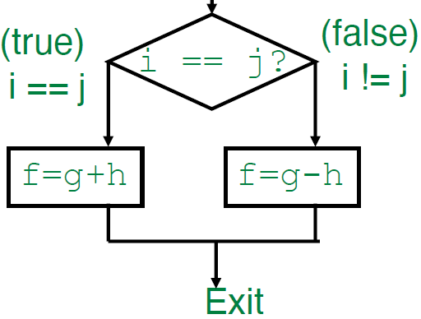
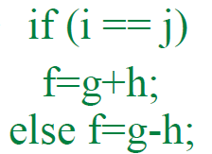
Control Instructions: Example
C code:
MIPS code:
beq $s3,$s4,True # branch i==j
sub $s0,$s1,$s2 # f=g-h (false)
j Exit # goto Exit
True: add $s0,$s1,$s2 # f=g+h (true)
Exit:
(Register mapping: f: $s0, g: $s1, h: $s2, i: $s3, j: $s4)

Slide 113
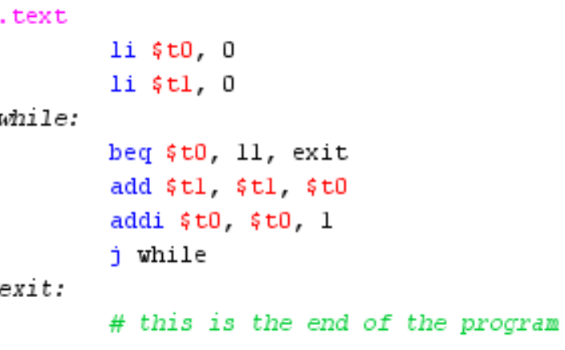
Loop
Using conditional branch, unconditional jump and label, you can also create loops
Example:
int count = 0;
int sum = 0;
while (count <11){
sum = sum + count;
count = count + 1;
}
int count = 0;
int sum = 0;
for (count = 0; count < 11; count++){
sum = sum + count;
}

Slide 114
Procedure (Function)
Procedure (or Function in C) are used to repeated perform essentially the same task with slightly different details
Executing a procedure must follow these six steps:
Put parameters in a place where the procedure can access them
Transfer control to the procedure
Acquire the storage resources needed for the procedure
Perform the desired task
Put the result value in a place where the calling program can access it
Return control to the point of origin, since a procedure can be called from several points in a program

Slide 115
Procedure Call Instructions
jump-and-link instruction (jal)
jal ProcedureAddress
Jump to the starting address of the procedure
At the same time, store the return address into $ra
saves PC + 4 in $ra
puts the parameter values in $a0–$a3
When the procedure finishes, use the jump register instruction (jr) to jump back to the caller
The return values are stored in $v0–$v1
jr $ra

Slide 116
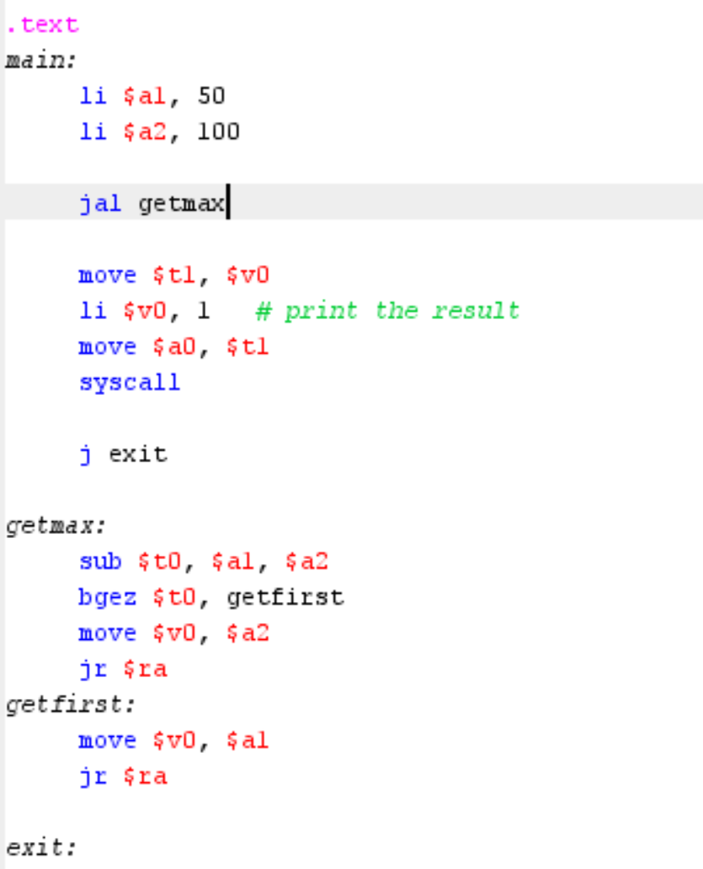
Procedure Call Instructions
Example:
Write a procedure to get the maximum of the two parameters
Call the procedure in “main”

Slide 117
MIPS Pseudo-Instructions
Pseudo-instructions are legal MIPS assembly language instructions that do not have a direct hardware implementation.
They are provided as a convenience for the programmer. When you use pseudo-instructions in a MIPS assembly language program, the assembler translates them into equivalent real MIPS instructions.

Slide 118
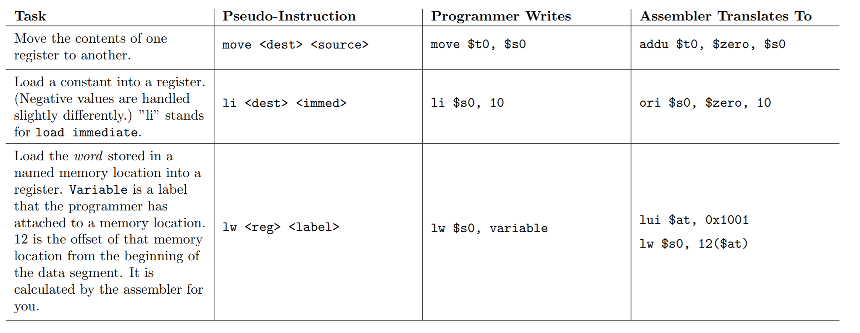
MIPS Pseudo-Instructions
Examples:

Slide 119
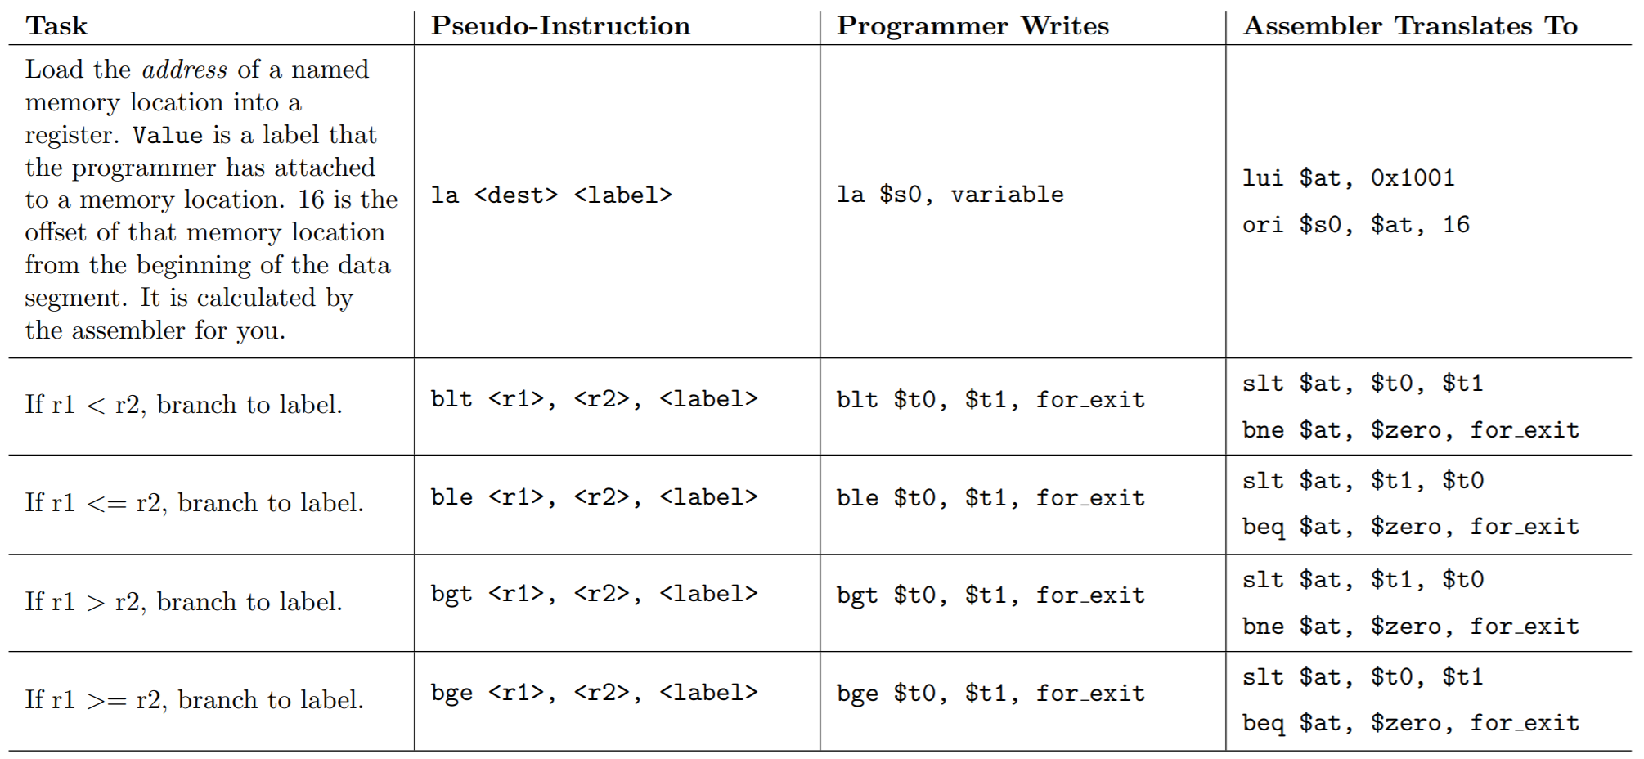
MIPS Pseudo-Instructions

Slide 120
System Calls
A system call (syscall) is the programmatic way in which a computer program requests a service from OS.
hardware-related services (for example, input/output)
creation and execution of new processes, and communication with integral kernel services such as process scheduling.
A number of system calls, mainly for input and output, are available for use by your MIPS program

Slide 121
System Calls Table
Step 1. Load the service number in register $v0. Step 2. Load argument values, if any, in $a0, $a1, $a2, or $f12 as specified. Step 3. Issue the SYSCALL instruction. Step 4. Retrieve return values, if any, from result registers as specified.
Service | Code in $v0 | Arguments | Result
print integer | 1 | $a0 = integer to print
print float | 2 | $f12 = float to print
print double | 3 | $f12 = double to print
print string | 4 | $a0 = address of null-terminated string to print
read integer | 5 |  | $v0 contains integer read
read float | 6 |  | $f0 contains float read
read double | 7 |  | $f0 contains double read
read string | 8 | $a0 = address of input buffer $a1 = maximum number of characters to read | See note below table

Slide 122
System Calls Table
Service | Code in $v0 | Arguments | Result
sbrk (allocate heap memory) | 9 | $a0 = number of bytes to allocate | $v0 contains address of allocated memory
exit (terminate execution) | 10
print character | 11 | $a0 = character to print | See note below table
read character | 12 |  | $v0 contains character read
open file | 13 | $a0 = address of null-terminated string containing filename $a1 = flags $a2 = mode | $v0 contains file descriptor (negative if error). See note below table
read from file | 14 | $a0 = file descriptor $a1 = address of input buffer $a2 = maximum number of characters to read | $v0 contains number of characters read (0 if end-of-file, negative if error). See note below table
write to file | 15 | $a0 = file descriptor $a1 = address of output buffer $a2 = number of characters to write | $v0 contains number of characters written (negative if error). See note below table
close file | 16 | $a0 = file descriptor
exit2 (terminate with value) | 17 | $a0 = termination result | See note below table

Slide 123
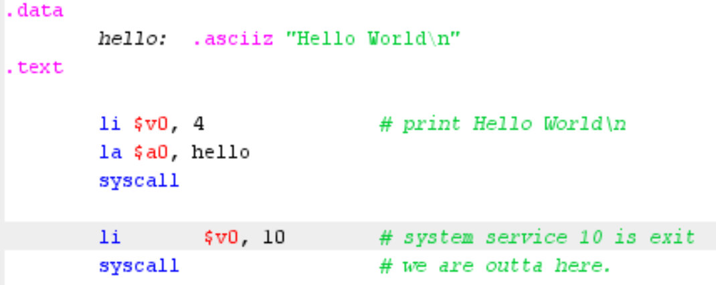
Exampe
Write assembly codes to print “Hello world!”

Slide 124
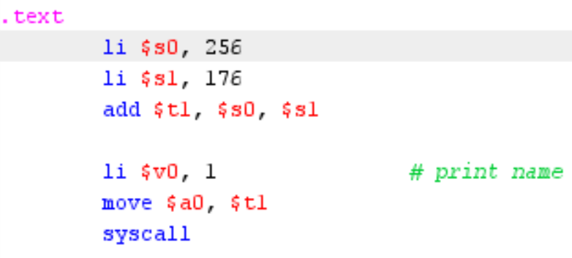
Example
Write assembly codes to calculate 256+172 and print the result

Slide 125
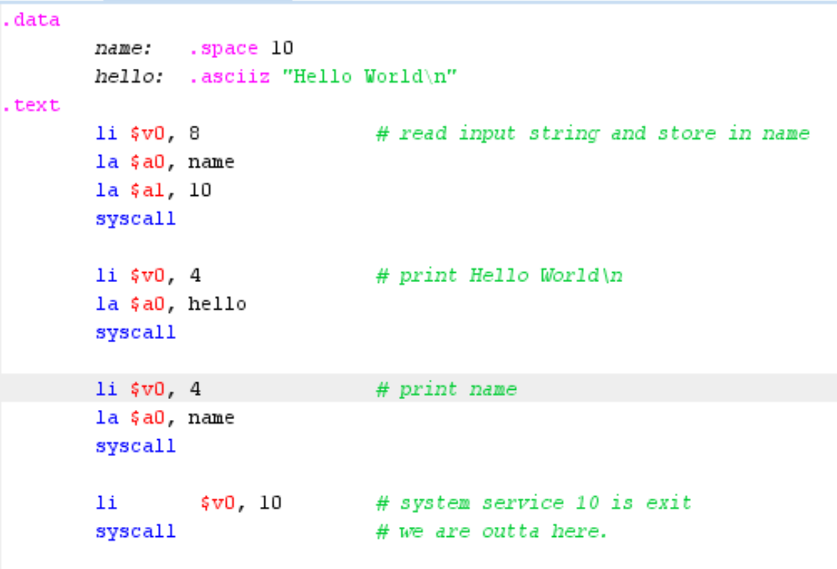

Example
Write assembly codes print “Hello world! My name is xxx”, where “xxx” a character string input by the user

Slide 126
Example
Write MIPS assembly codes to compute and print the result of x+(x-1)+(x-2)+…+1, where x is input by users (suppose x < 100). The codes to read input and print the result are already given as follows, and please write the remaining codes.

Slide 127
Example
Write MIPS assembly codes to compute and print the result of x+(x-1)+(x-2)+…+1, where x is input by users (suppose x < 100). The codes to read input and print the result are already given as follows, and please write the remaining codes.
.text move # read the input x, and put it into register $t1 li $v0, 5 syscall move $t1, $v0 move $t2, $v0 loop: sub $t1, $t1, 1 add $t2, $t2, $t1 bne $t1, 1, loop li $v0, 5 syscall

Slide 128
Midterm
In-class: Oct. 18 (Week 7, Wed)
Closed-book, calculator allowed
Scope: Chapter 1 - 4
Bring your own white paper as answer sheets and draft paper
Midterm exam time length: 2 hours (9:00-11:00)
11:00-11:20: collecting answer sheets & break
11:20-11:50: Q&A

Slide 129
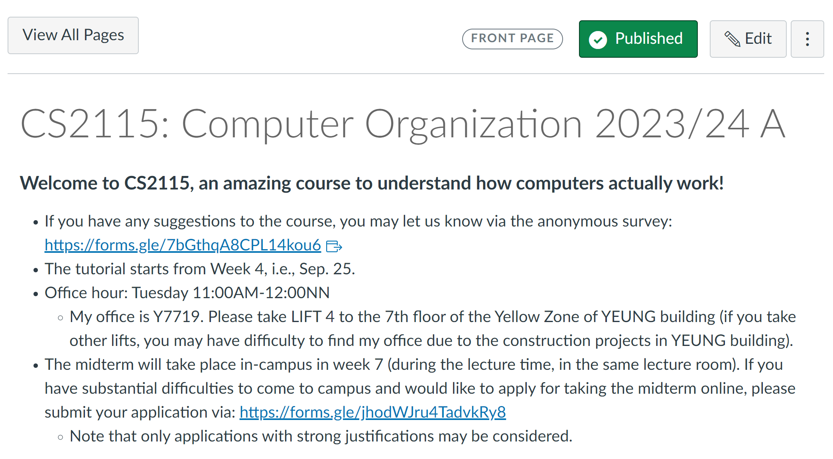
Midterm
If you cannot come to campus for valid reasons, apply for online midterm here: https://forms.gle/jhodWJru4TadvkRy8
Only applications with strong justifications may be considered
Application due: Oct 15
Spontaneous application considered
only for emergent reasons (e.g., health)

Slide 130
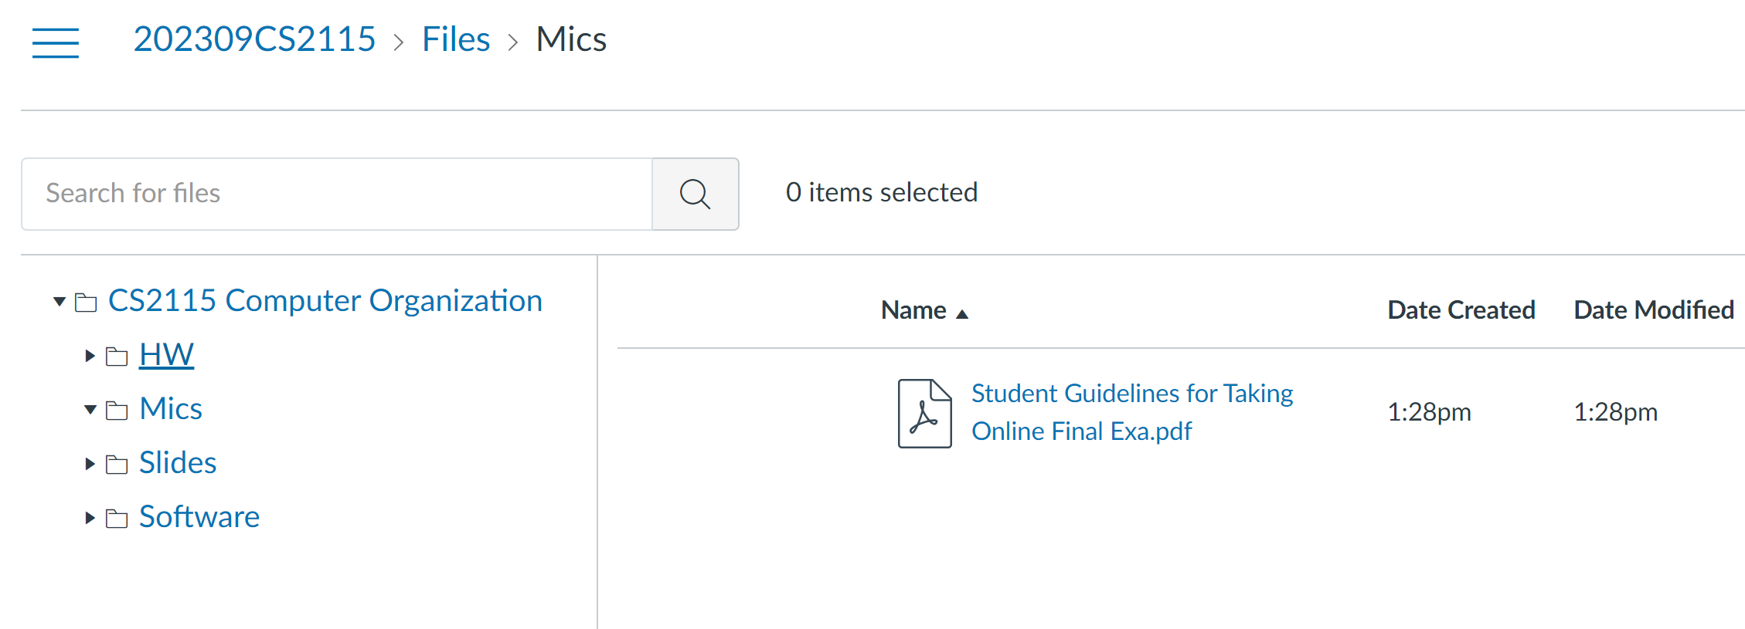
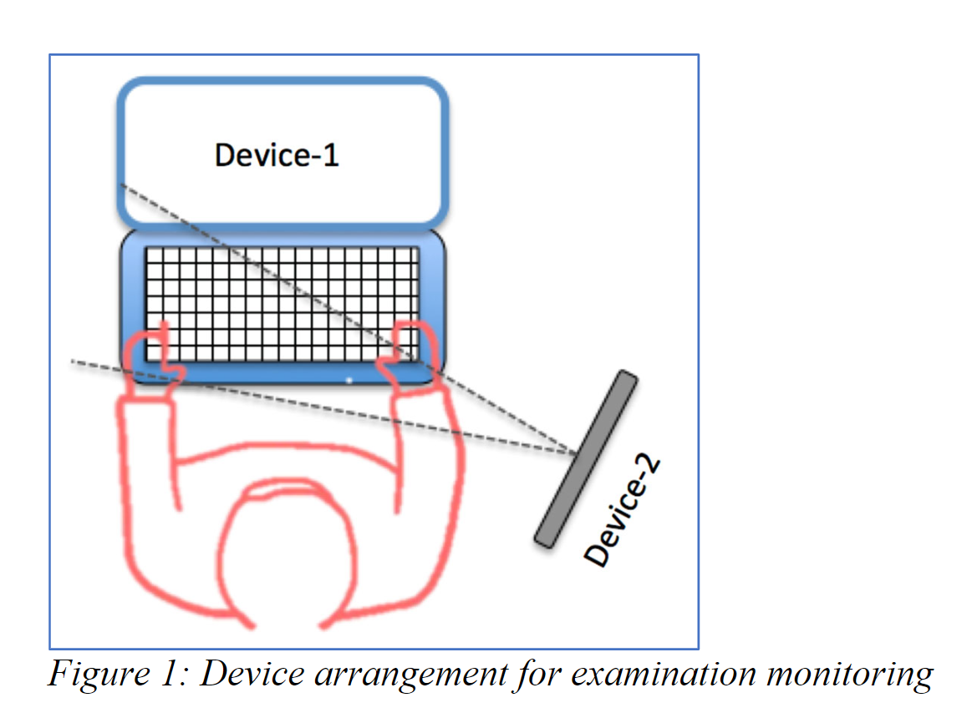
Midterm
If you get my explicit approval for taking the midterm online
Zoom link for online exam will be posted on Canvas in due course
For the requirement of taking online exam, please read
If you fail to comply with the requirement, your
answer will not be graded.

